Slide 1
10/18/2016 Tagup
C. Schiff

Slide 2
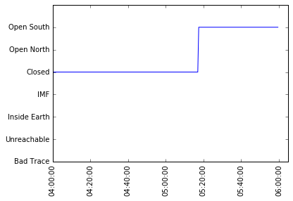
Oct 26/04:00–06:00: Field Type
Field line structure assessed using:
Tsyganenko 89 with dynamic Kp
MEC file fieldline_type query
Data indices – 480-720
Valid Range

Slide 3
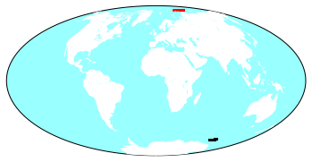
Oct 26/04:00–06:00: Geodetic Foot Print Location
Geodetic Foot Print Location assessed using:
Tsyganenko 89 with dynamic Kp
MEC file pfn_geod_latlon & pfs_geod_latlon query
Data indices – 480-635 (note that the valid indices comprise a smaller range indicating a failure to find the footprint – investigating this)

Slide 4
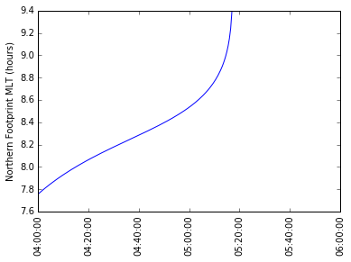
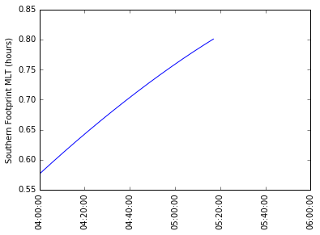
Oct 26/04:00–06:00: Footprint Magnetic Local Time

Slide 5
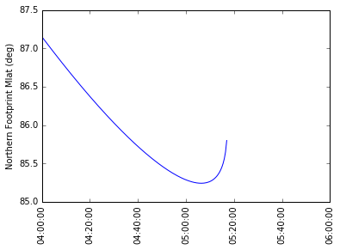
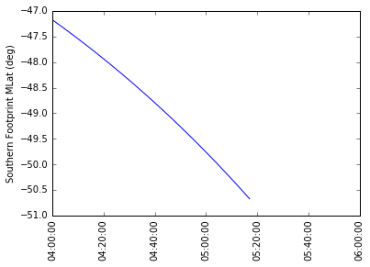
Oct 26/04:00–06:00: Footprint Magnetic Latitude

